Slide 1

The war on attrition created for: kim Wexler, Head of HR presented by: Ashlynn Duncan keith wright kelvin idogun bain & company

Slide 2

AGENDA
Executive summary
Data
Predictive Model
Recommendation/Next Steps

Slide 3

Executive summary

Slide 4
Executive summary
Problem statement
Proposed solution
Stakeholder is facing an unprecedented amount of employee attrition/churn rates and wants to use company HR data to determine what insights you can gain from it
After running many analyses of your data, our team decided to leverage the decision tree as our model due to its ability to target and show specific features that have a stronger impact on attrition

Slide 5
Predictive model

Slide 6
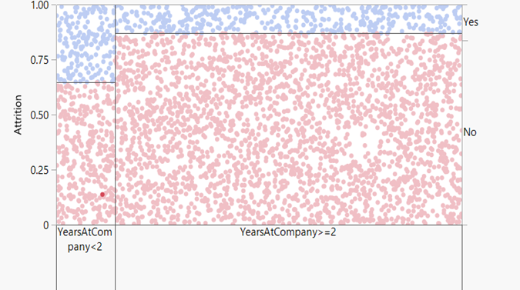
Predictive model
Decision Tree
Based on our decision tree, we have a R-square value of 0.043 for training data using 3500 data points. We have a R-square value of 0.042 for validation data using 870 data points.
Based on this, we believe our model has acceptable performance
Notes:
Independent variable being years at the company and dependent being if attrition will occur

Slide 7
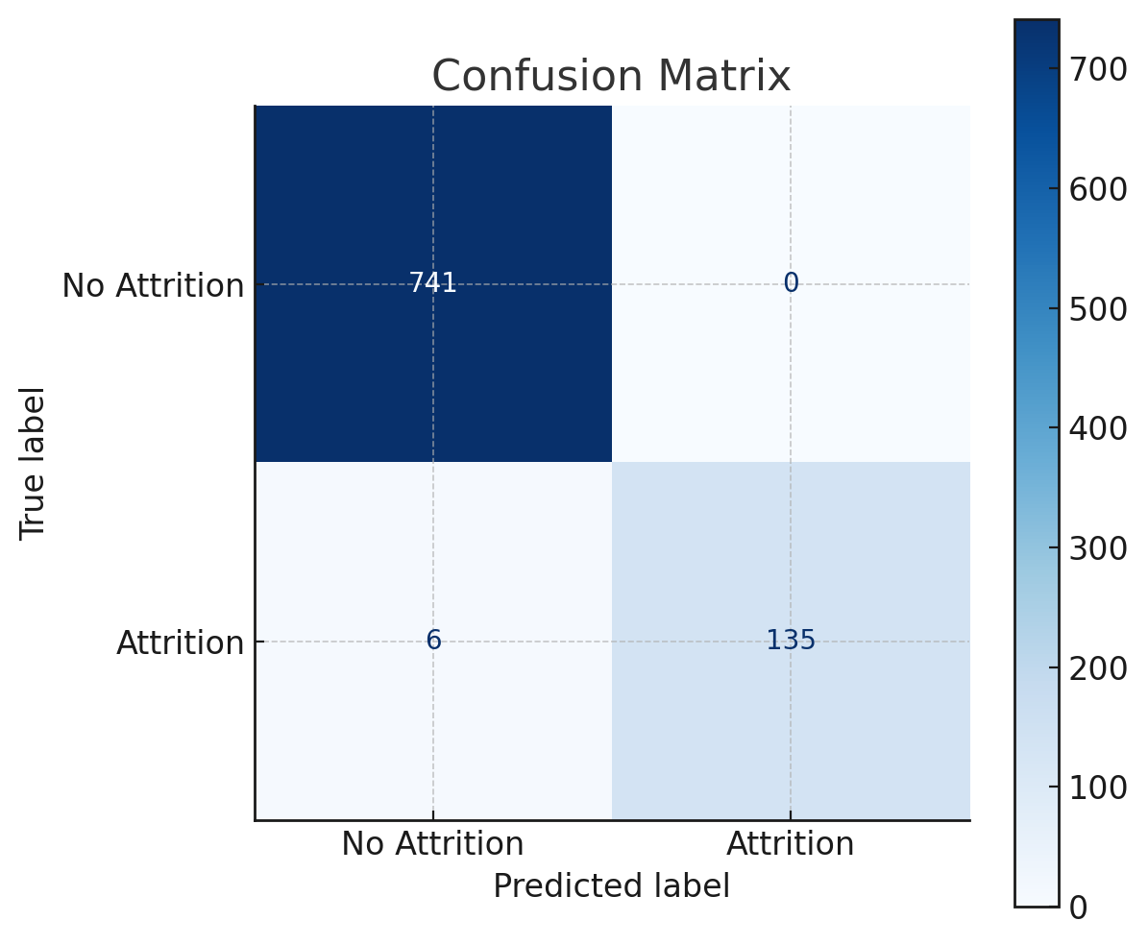
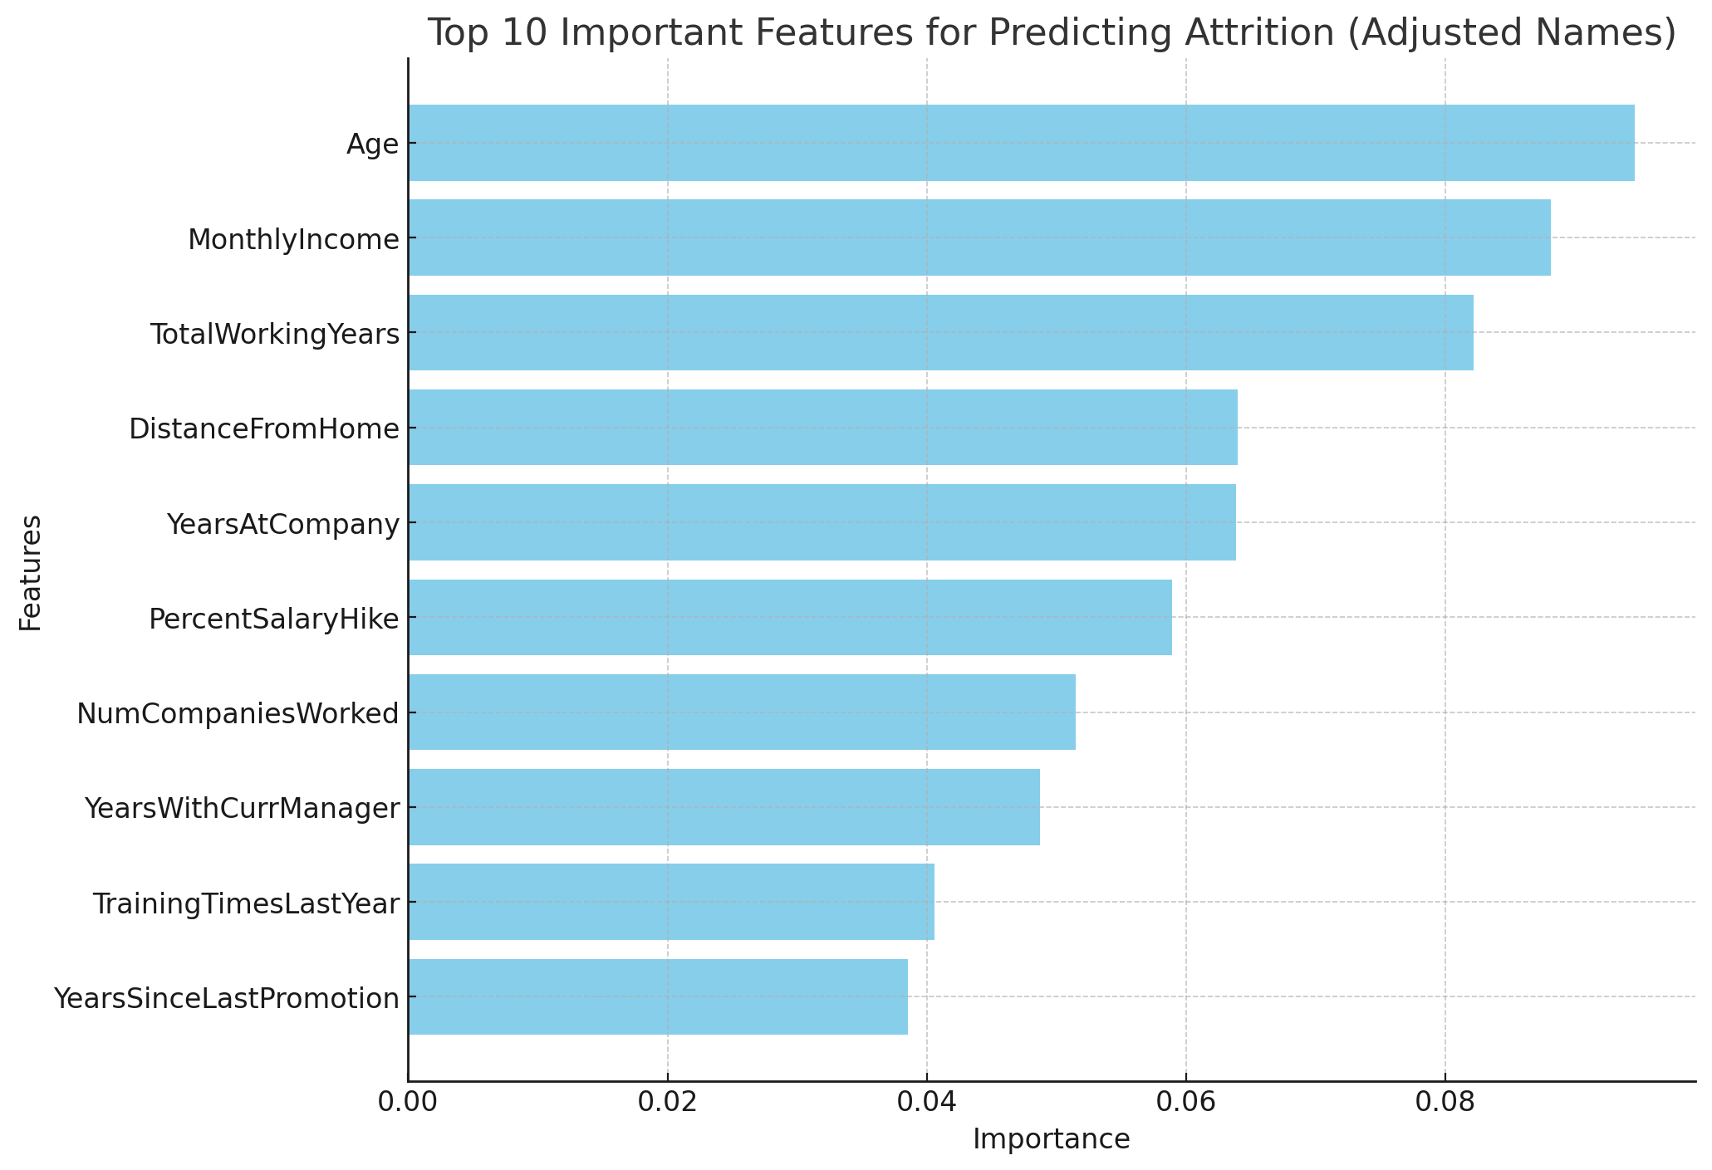
Predictive modelS
Feature Importance
Confusion Matrix
Notes:
Age of employees have a high impact on attrition
Features: top 10 that have highest impact on attrition

Slide 8
Recommendation/next steps

Slide 9
For early year employees and <20 years of age, we recommend these next steps for you and the family:
Flexibility to WFH
Improving benefit package (stock options, Unlimited PTO, health/wellness insurance, home office stipend, etc)
Civic engagement
Career development opportunities
Managerial feedback on performance
We believe these key changes will entice & inspire employees to stay and reduce attrition. .

Slide 10

THANK YOU!
Ashlynn Duncan
Keith Wright
Kelvin Idogun
Bain & Company
E: team12@bainandcompany.com

Slide 11
Appendix

